Slide 1
DELETION in AVL Trees

Slide 2
Deletion in AVL Tree
Deleting a node from an AVL tree is similar to that in a binary search tree.
Deletion may disturb the balance factor of an AVL tree and therefore the tree needs to be rebalanced in order to maintain the AVLness.
For this purpose, we need to perform rotations. The two types of rotations are L rotation and R rotation
Let us consider that, A is the critical node and B is the root node of its left sub-tree. If node X, present in the right sub-tree of A, is to be deleted, then there can be three different situations:

Slide 3
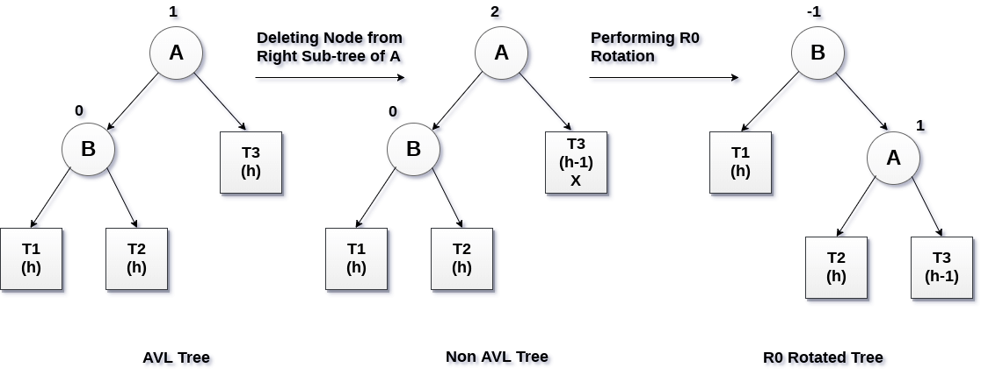
R0 rotation (Node B has balance factor 0 )
If the node B has 0 balance factor, and the balance factor of node A disturbed upon deleting the node X, then the tree will be rebalanced by rotating tree using R0 rotation.
R0 → LL Case → Right Rotation at critical node

Slide 4
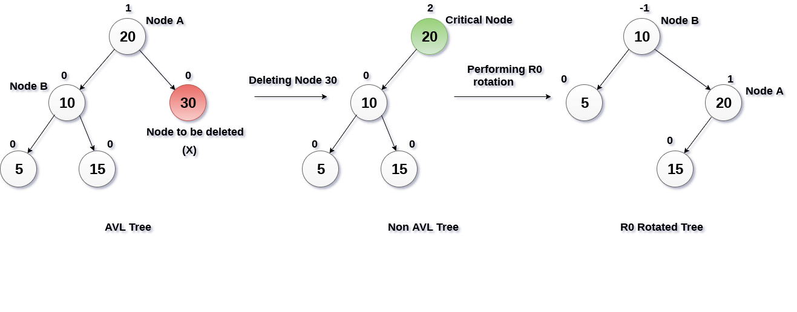
Example - R0

Slide 5
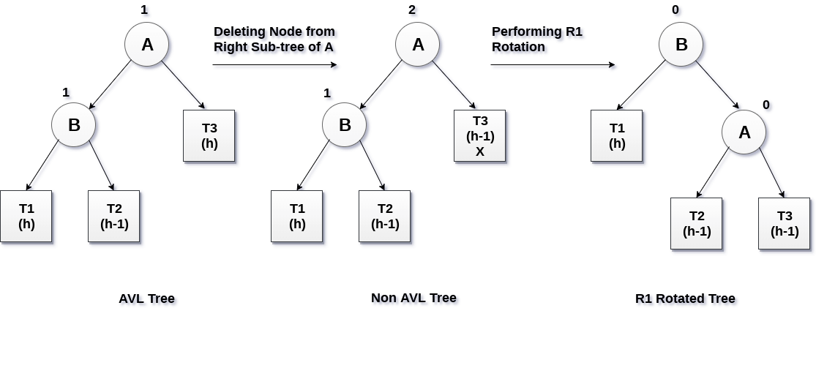
R1 Rotation (Node B has balance factor 1)
R1 Rotation is to be performed if the balance factor of Node B is 1.
In R1 rotation, the critical node A is moved to its right having sub-trees T2 and T3 as its left and right child respectively. T1 is to be placed as the left sub-tree of the node B.
R1 → LL Case → Right Rotation at critical node

Slide 6
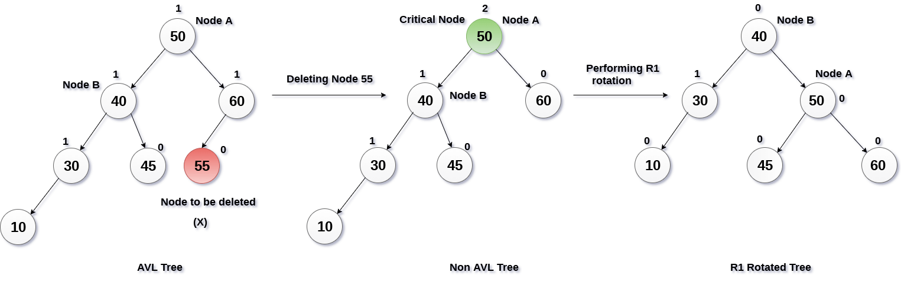
Example - R1

Slide 7
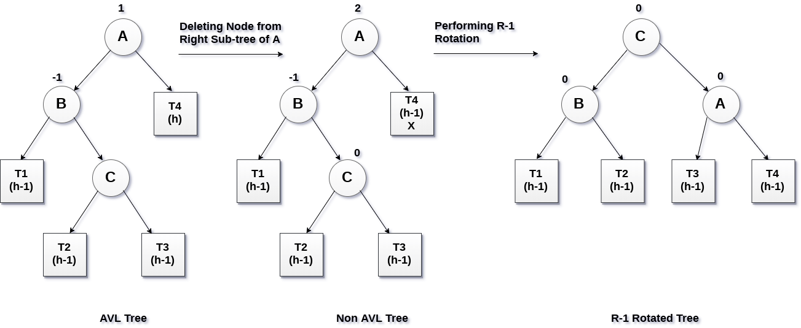
R-1 Rotation (Node B has balance factor -1)
R-1 rotation is to be performed if the node B has balance factor -1.
This case is treated in the same way as LR rotation.
In this case, the node C, which is the right child of node B, becomes the root node of the tree with B and A as its left and right children respectively.
R-1 → LR Case → Left Rotation at parent and Right Rotation at critical node

Slide 8
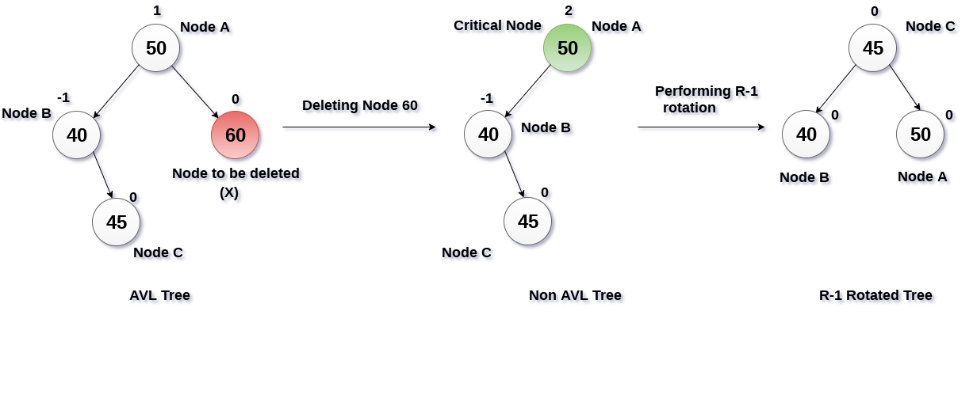
Example R-1

Slide 9
In deletion of any node in AVL tree, The two types of rotations can be made . They are L rotation and R rotation.
As R rotations are discussed in previous slide. L rotations are the mirror images of them.
R rotations
R0 → LL Case
R1 → LL case
R -1 → LR case
L rotations
L0 → RR Case
L1 → RL Case
L -1 → RR Case

